Slide 1


+
August 29, 2022
Driver Performance
Owner
badeyemi

Slide 2

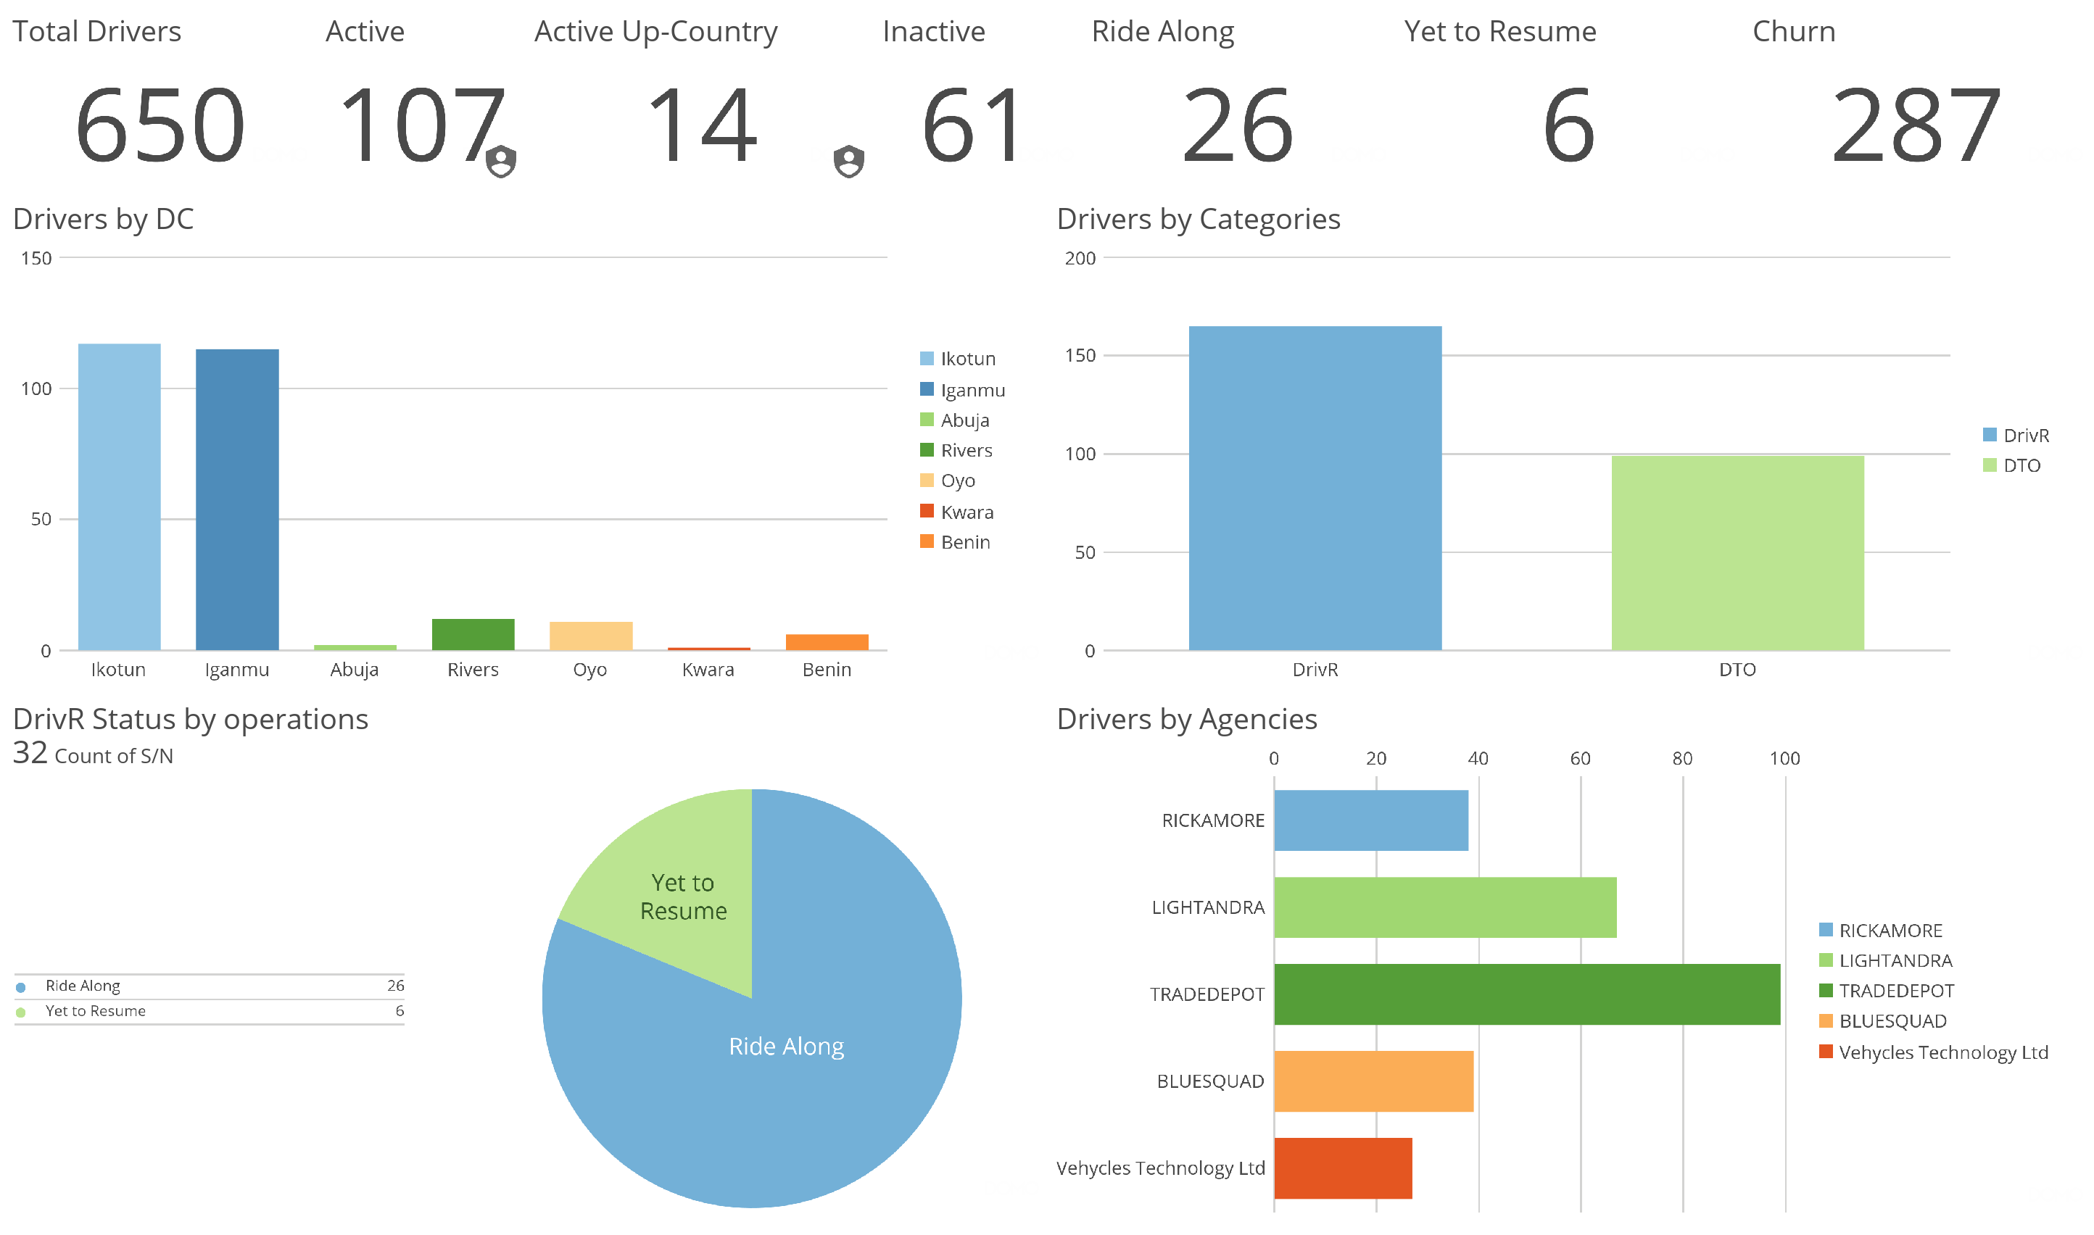
Overview

Slide 3
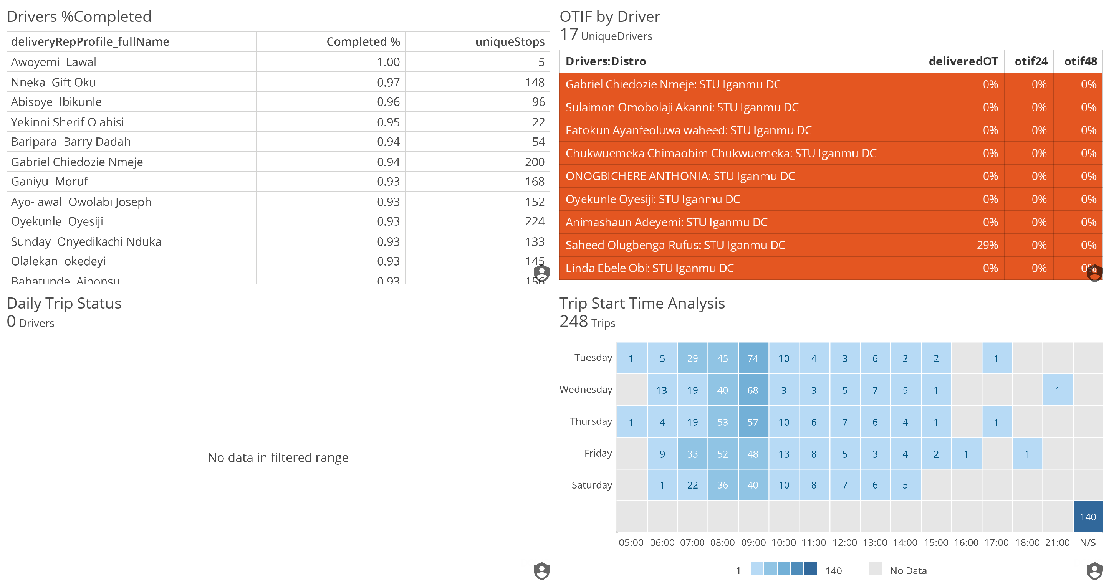
Delivery Performance

Slide 4


Compliance

Slide 5


Appendix

Slide 6
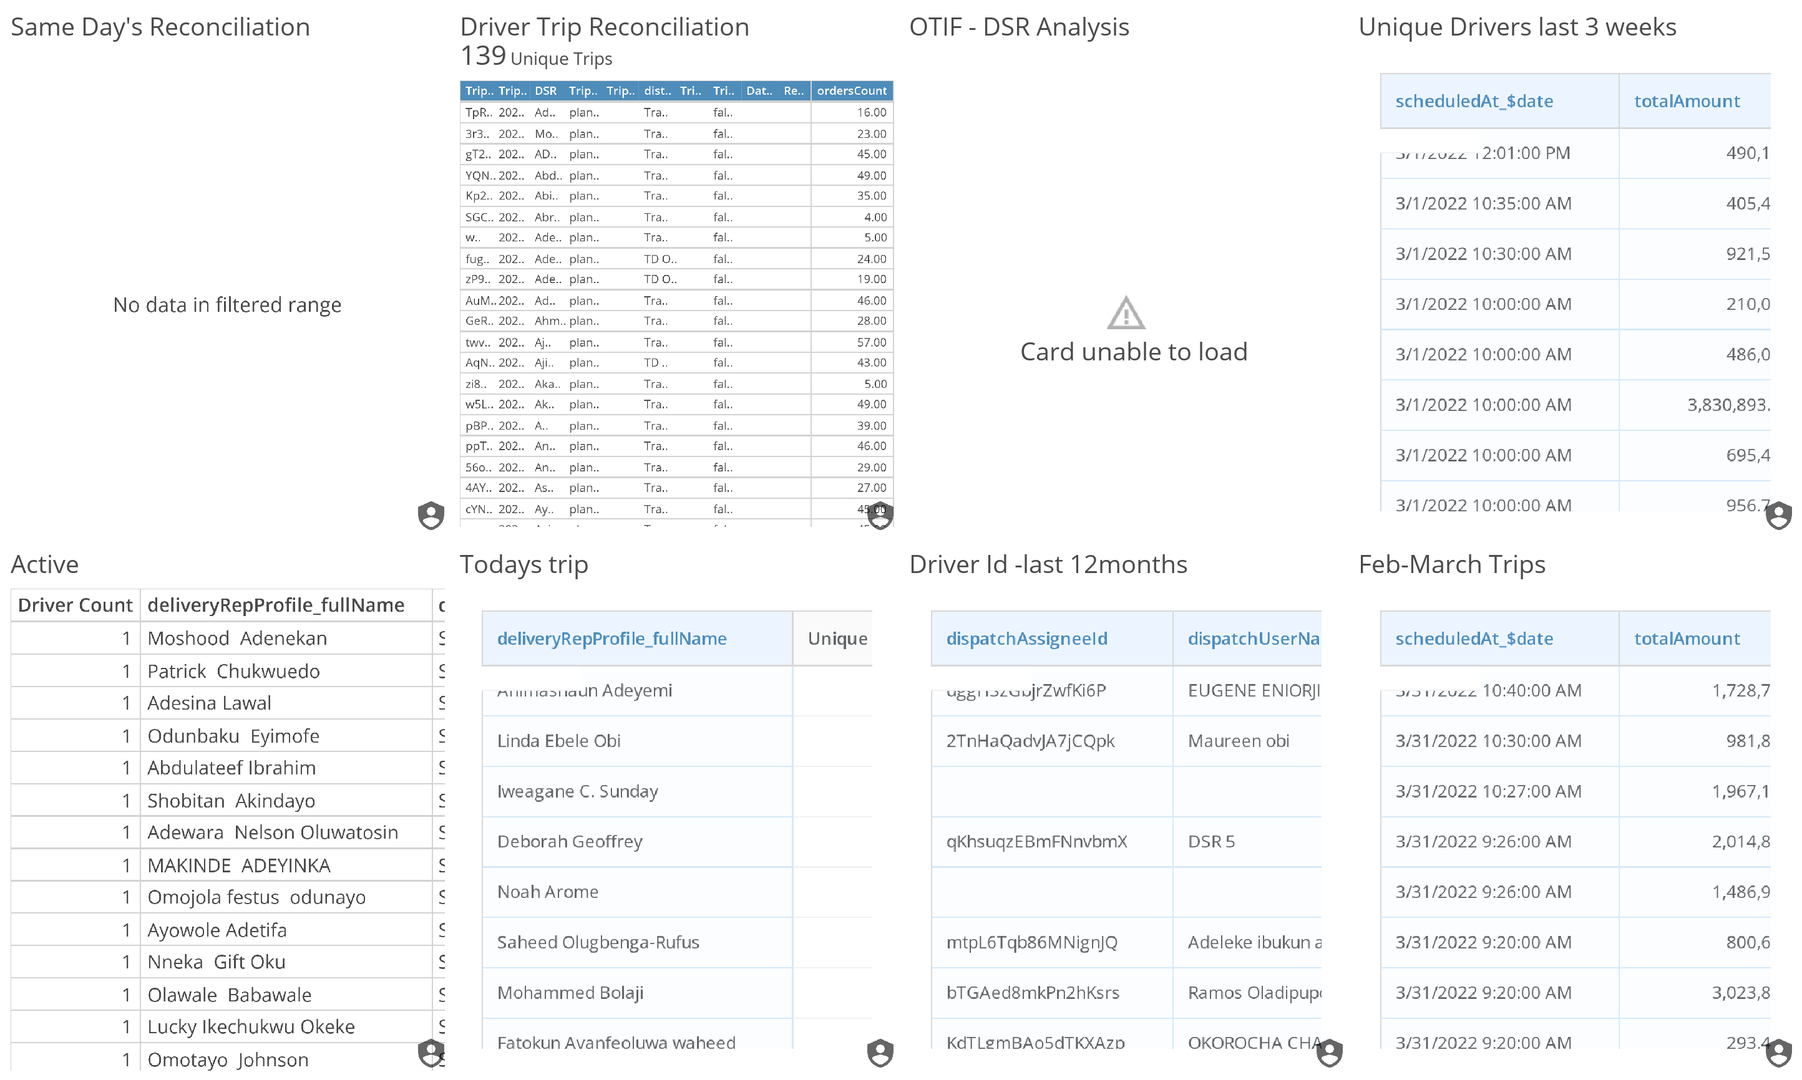

Slide 7


